Slide 1
NATURAL LANGUAGE PROCESSING
Dr. Lipika Dey, Adjunct Professor, IIT Jodhpur
Dr. Tirthankar Dasgupta, Senior Scientist, TCS Research

Slide 2
Syllabus
Introduction to NLU
Basics of Linguistics
NLP Tools
ML for Text Analytics
Annotation and Evaluation
Language Models
Text Embeddings
Masked Language Models
Large Language Models
Analytical and Generative NLP with different types of Language Models
Information Extraction, Information Retrieval, Text Classification, Clustering, Question Answering, Translation, Summarization, Conversation
Issues with existing language models
Knowledge Graphs and Text Processing
Ethics and NLP

Slide 3
Marks Distribution
Written Exams
Minor 1 - 10
Minor 2 - 10
Major - 20
Coding Assignments - 30 -
Groups will have to be formed at the beginning and continued throughout
Timeliness, Documentation, Code quality, Results
Assignment Presentations / Paper Reading and Presentation/ Viva Voce - 30
Interaction with individuals
Dependance on Coding assignments may be there
Even if team assignments - marks will be awarded based on individual presentation

Slide 4
Web resources
Speech and Language Processing (3rd ed. draft) by Dan Jurafsky and James H. Marting -
https://web.stanford.edu/~jurafsky/slp3/

Slide 5
What we discuss today
What is Natural Language Processing (NLP)?
Where is it applied?
What are some tools available? Why is NLP hard?

Slide 6
What is Natural Language Understanding
Natural language processing (NLP) started in the 1950s as an area of research that wanted to facilitate Human Computer Interaction using natural languages that we speak

Slide 7
What NLP entails
Aspects of Language
Coding and Implementation
Linguistics
Computer Science
Artificial Intelligence
Information Engineering
Uncertainties and Vagueness
Solving the Task at hand

Slide 8
Two types of Needs
Natural Language Processing
Natural Language Understanding
Find all documents containing information about “carbon capture”
Natural Language Generation
Generate a Summary of advantages and disadvantages of Carbon Captue technology

Slide 9
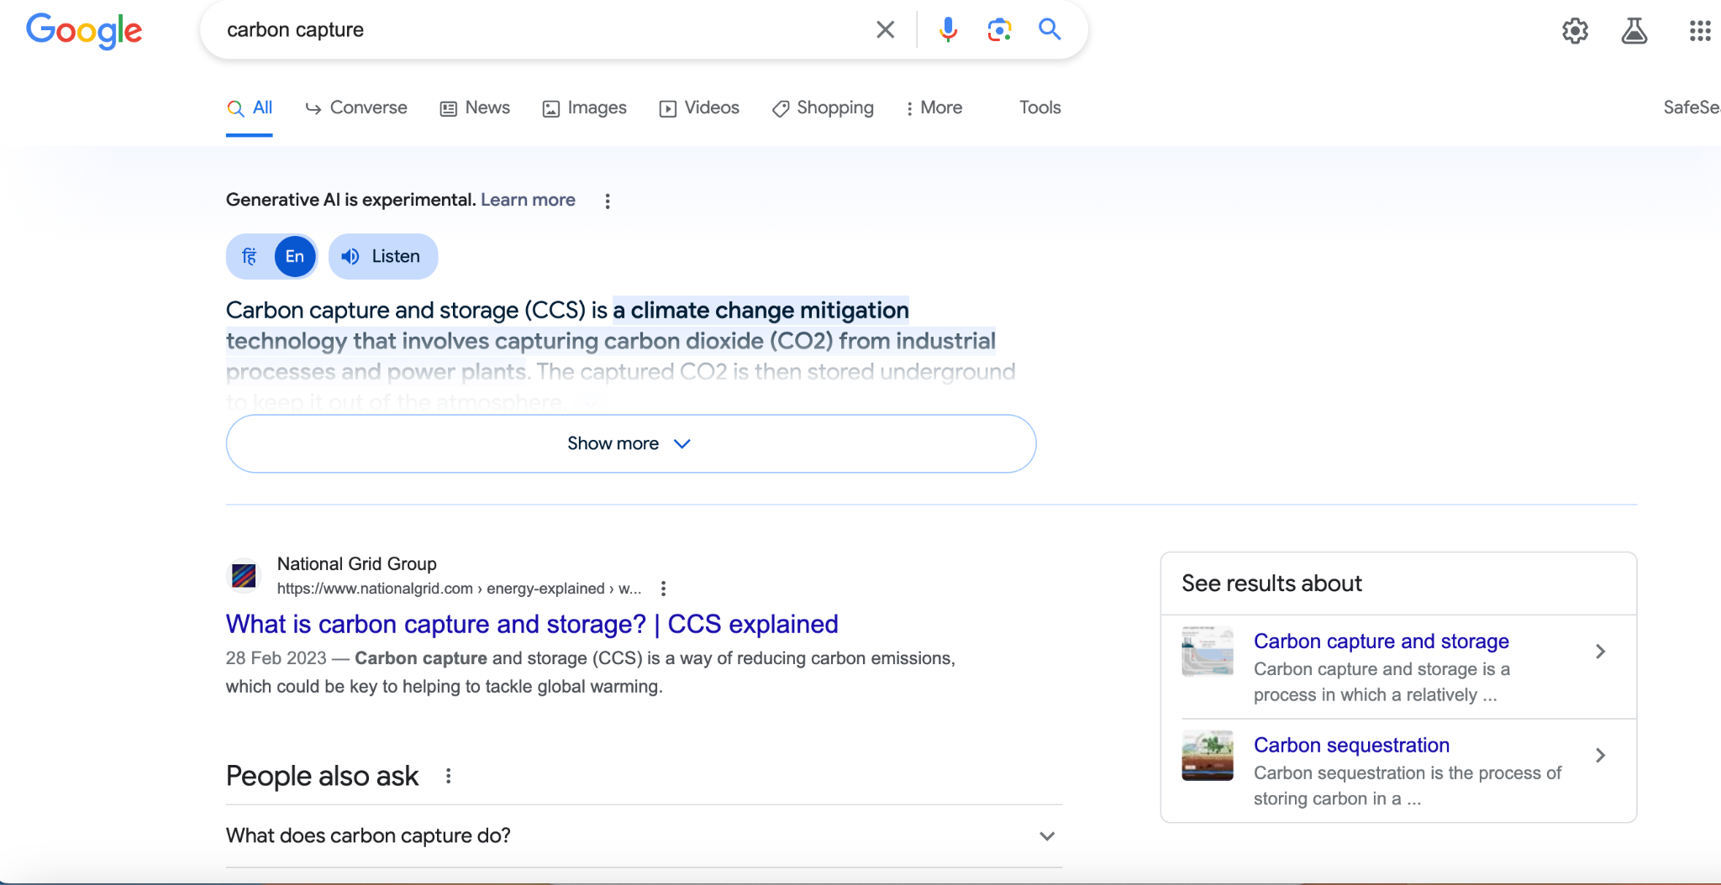

Slide 10
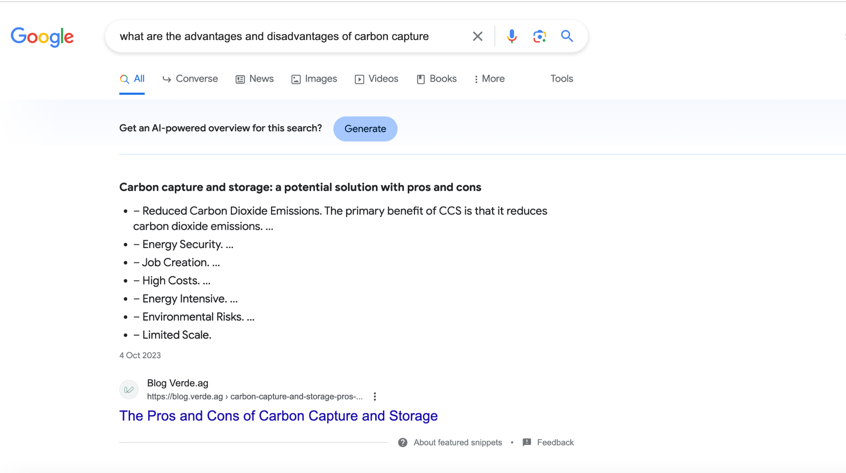
Quite Bad

Slide 11
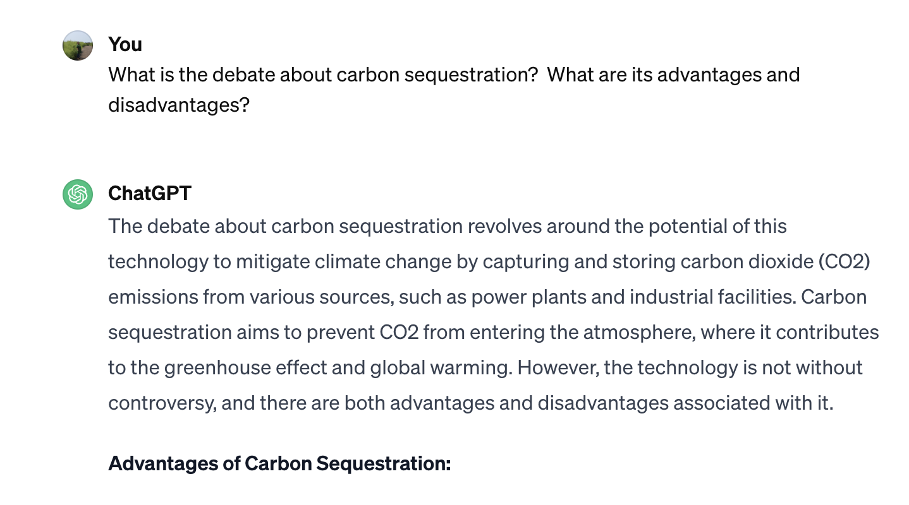
Advantages of Carbon Sequestration:
Climate Change Mitigation: By capturing and storing CO2 emissions, carbon sequestration can help reduce the concentration of greenhouse gases in the atmosphere, contributing to efforts to mitigate climate change.
Utilization of Existing Infrastructure: Carbon capture and storage (CCS) technologies can be integrated into existing power plants and industrial facilities, allowing for the continued use of fossil fuels while reducing emissions.
Compatibility with Various Sectors: Carbon sequestration can be applied to various sectors, including power generation, cement production, and other industries that are challenging to decarbonize using other methods.
Disadvantages and Concerns:
Cost: One of the primary concerns is the high cost associated with implementing carbon sequestration technologies. The capture, transportation, and storage of CO2 can be expensive, making it economically challenging, especially for developing countries.
Energy Requirements: The process of capturing and compressing CO2 requires energy, and this can result in a net reduction in the efficiency of power plants or industrial processes where carbon capture is implemented.
Storage Risks: The long-term storage of CO2 in geological formations raises concerns about potential leakage, which could have environmental and safety implications. Ensuring the secure and permanent storage of CO2 is a critical challenge.
Infrastructure and Scale-Up Challenges: Implementing widespread carbon sequestration requires significant infrastructure development and scaling up of technology, which poses logistical challenges and may take time.
Quite good

Slide 12
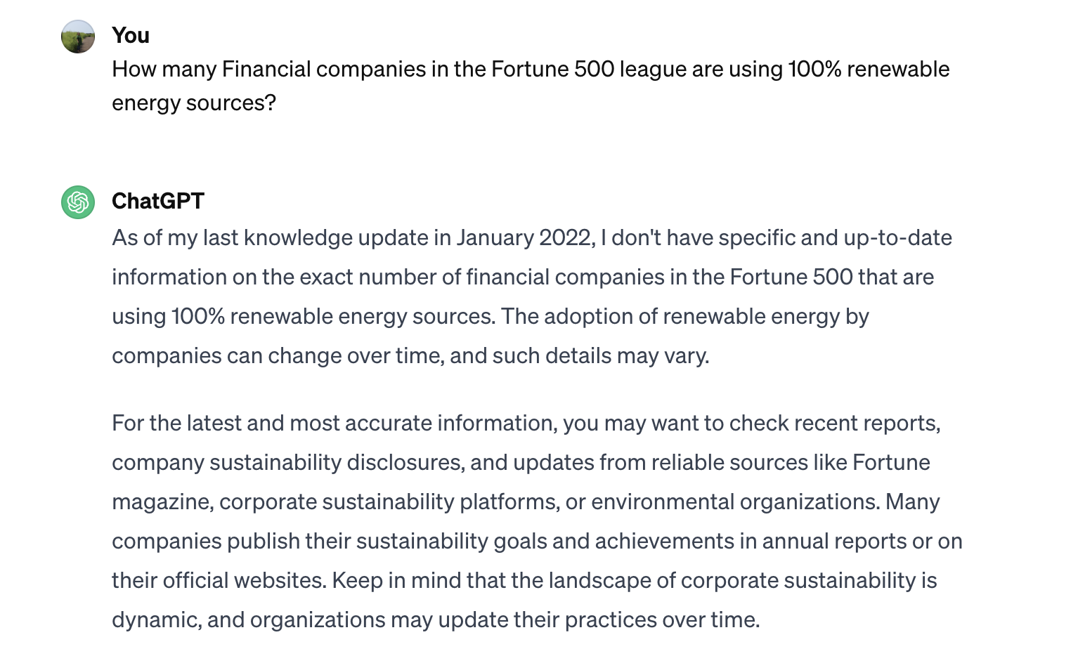
Not good

Slide 13
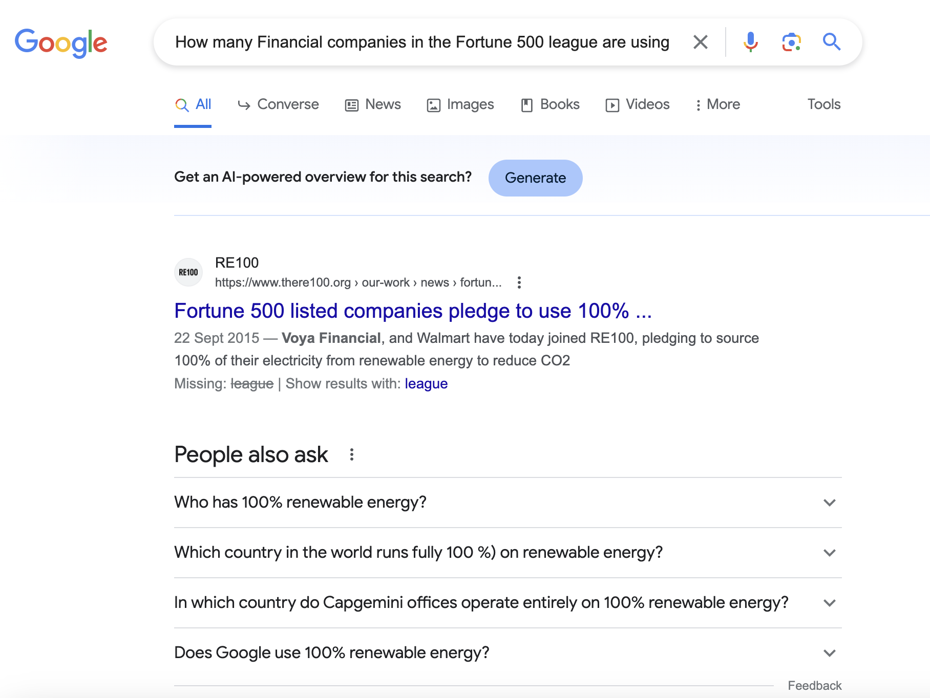
Not exact but not bad

Slide 14
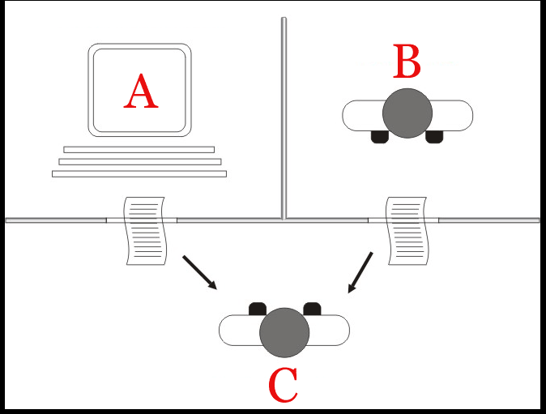
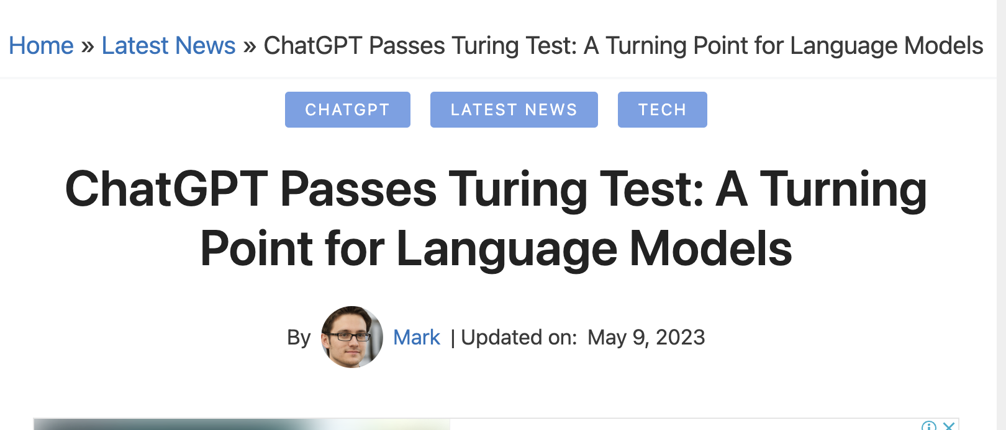
Turing Test
C - the interrogator, has to determine which player – A or B – is a computer and which is a human based on the responses to written questions

Slide 15

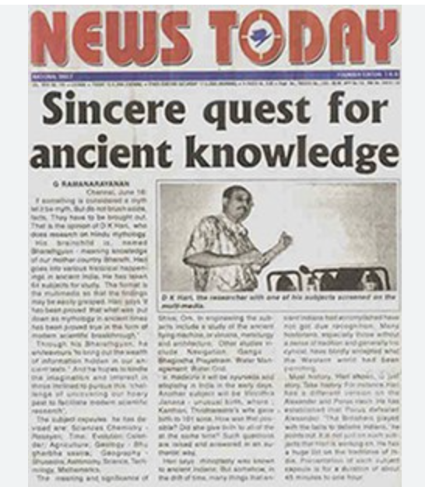
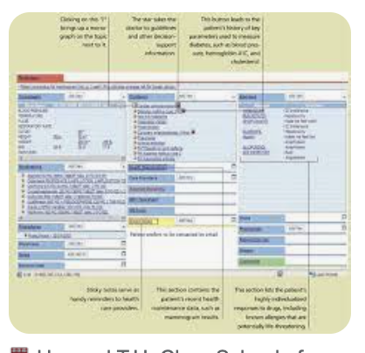
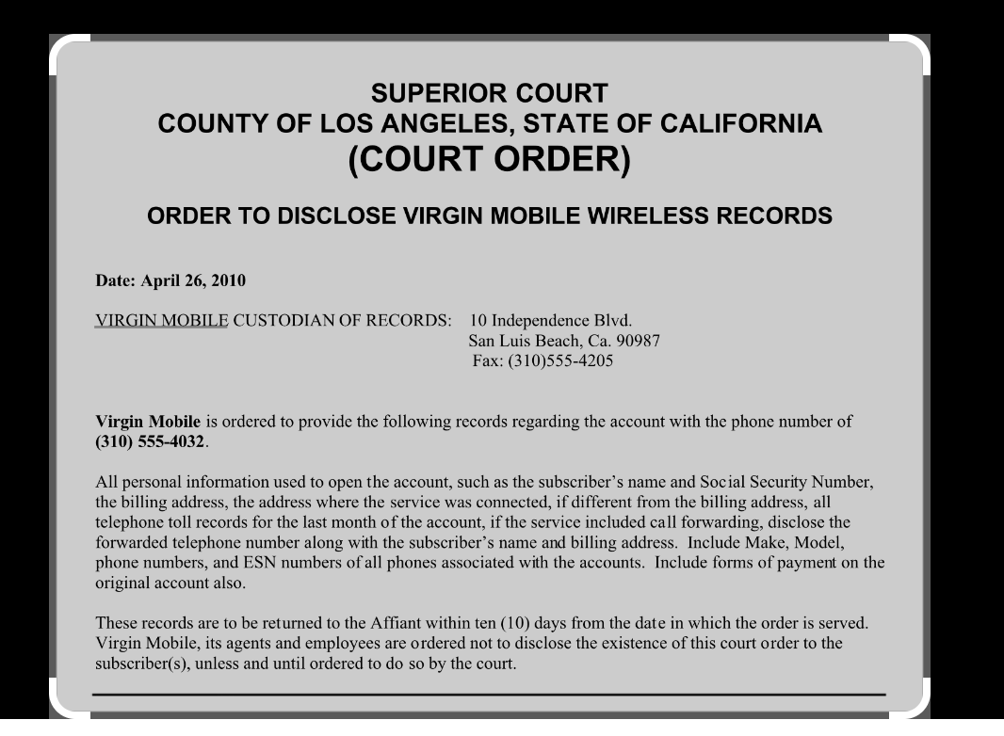
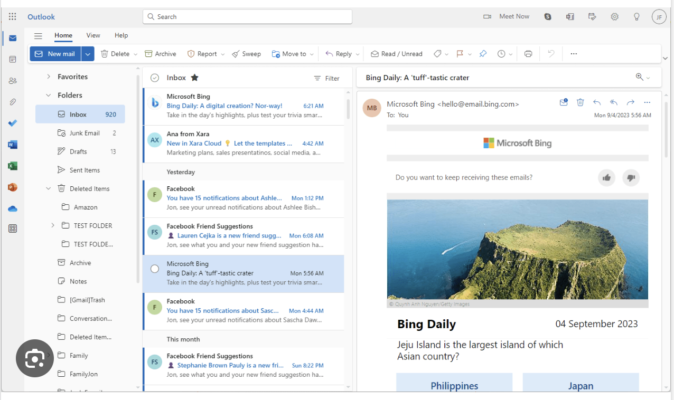
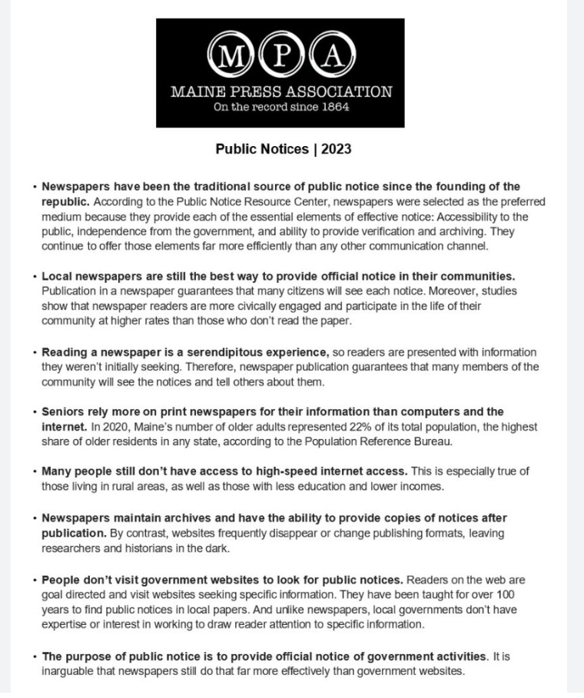

Why Natural Language Processing
To enable automated “characterization and understanding” of humongous Volumes of linguistic content generated at rapid Velocity in the form of conversations, writing, and other media

Slide 16
Problem Solving with NLP

Slide 17
Applications
Consumer Sentiment Analysis
What are consumers saying about a product / organization / dealer
Risk Assessment
What would be the risk if a new contract is signed with suppliers of Palm Oil from Indonesia?
Is it a good time to invest in Computer Games startups?
Healthcare
How are patients reacting to the new drug
Insurance
Given a person’s medical history and past claims by similar clients - what should be the underwriting value?
Given the climate and details of an area - what would be the risk of insuring a new field?

Slide 18
What is your dream NLP task?

Slide 19
Has it changed in a year?
Responses from students
Smart assistant - Alexa, Siri - weather, sports, news, directions, voice commands for home automation
cannot understand all languages
can’t converse
syntactically correct commands only
can’t understand intent - expectation not met - ambiguity
doesn’t understand emotion of voice
Language Translator
Predictive typing - gmail
Email filter - spam / non-spam/ promotional
Text auto-correction -
Story completion game
Sentiment analysis - reviews of the product - features of the product
Summarization -
Entities and Relations Knowledge Graph – > Transactions → fraud?
Crime News - Semantic role Labeling
Question - Answering Systems

Slide 20
Analysis of Text needs
Understanding of the relationships between linguistic utterances and the world
Understanding of the linguistic structures by which language communicates
Some understanding about cognitive aspects of how humans acquire, produce, and understand language

Slide 21
How many patients reported adverse reaction to drug Telma 40?
Under what conditions?
Extracting Sentiments , onions
Given the description of the accident is it a fraud / not?
Given the patient history what should be the premium based on past claims by similar people
Risk Assessment
Information Extraction - Drug names, symptoms
Sentiment Analysis
Insurance Underwriting
Linking information from multiple sources
What are the causes a disease?
What is the policy for Paternity leave?
Summary of Financial obligations on signing a new contract with an alliance
General Purpose Conversation - Question
Understand & Empathize
Answer / Guide /Recommend
Any language to any language
Question Answering
Summarization
Natural Language generation
Machine Translation

Slide 22
Language understanding entails
Lexical analysis - break down text into paragraphs, sentences, and words
manormachinesavestime
Parsing - find out the grammatical structure of sentences.
Semantic analysis - dictionary meanings of words.
Discourse integration - makes sense of text meaning with context.
Pragmatic analysis - understand sentiment, intent and other intended information from text

Slide 23
Understanding Text
Linguistic structure - parsing
Cow eats green grass / green eats cow grass
Semantic aspects
Which one is correct - she loves books / books love her
Understanding discourse
The bank was submerged / The manager of the bank was killed.
When can we infer - the bank was robbed?
Cognitive aspects
Come what may, he never misses his morning run
Pragmatic aspects
Her dog expired today morning.
Not a right time to serve her a Dog-food advertisement

Slide 24
LINGUISTIC ESSENTIALS

Slide 25
Parts of Speech and Morphology
Words of a language belong to different classes
Each class exhibits a distinct behavior
Distinct syntactic behavior
Typical semantic behavior
Also referred to as Parts of speech (POS)

Slide 26
Linguistic structure
Words from different POS categories are expected to be in a particular sequence in a sentence
Ayan (Proper Noun) gave (verb) the (determiner) book (common noun) to (preposition) Nayan (Proper Noun)
Ayan (Noun) gave (verb) a (determiner) book (common noun) to (preposition) Nayan (common noun) for …………..
Ayan (Noun) gave (verb) books (common noun) to (preposition) Don Bosco school (common noun) for …………..

Slide 27
Structure is not unique for an intended semantics
Language puts constraint on the order of words in a sentence
book this prepared material have Manning’s from I
I have prepared this material from Manning’s book
This material, I have prepared from Manning’s book
From Manning’s book I have prepared this material
Prepared this material I have from Manning’s book

Slide 28
Structure and Semantics
A syntactic analysis of a sentence tells us how to determine the meaning of the sentence from the meaning of the words
Ayan gave a book to Nayan
Nayan gave a book to Ayan
Order matters
Who owns the book now?
Phrase tree helps in understanding the structure

Slide 29
Phrase Structure Tree
A phrase structure tree (PS tree) is a graphic representation of how a speaker understands the structure of sentences in their language.
It shows that a sentence is a linear string of words and a hierarchical structure with phrases nested within phrases

Slide 30
POS and NLP tasks
Noun
names of people / place /organizations /concepts
Verb
Express action
Adjective
Describe properties of Noun

Slide 31
Named Entity Recognition
What are Named entities
Named entities refer to the key subjects of a piece of text - such as names of people, locations, companies, events and products, as well as themes, dates, addresses, times, monetary values, percentages etc.
What is Named Entity Recognition
computational task of extracting and classifying Named Entities of predefined types from text
Why NER
Automates the task of quickly extracting key information from large amounts of text data

Slide 32
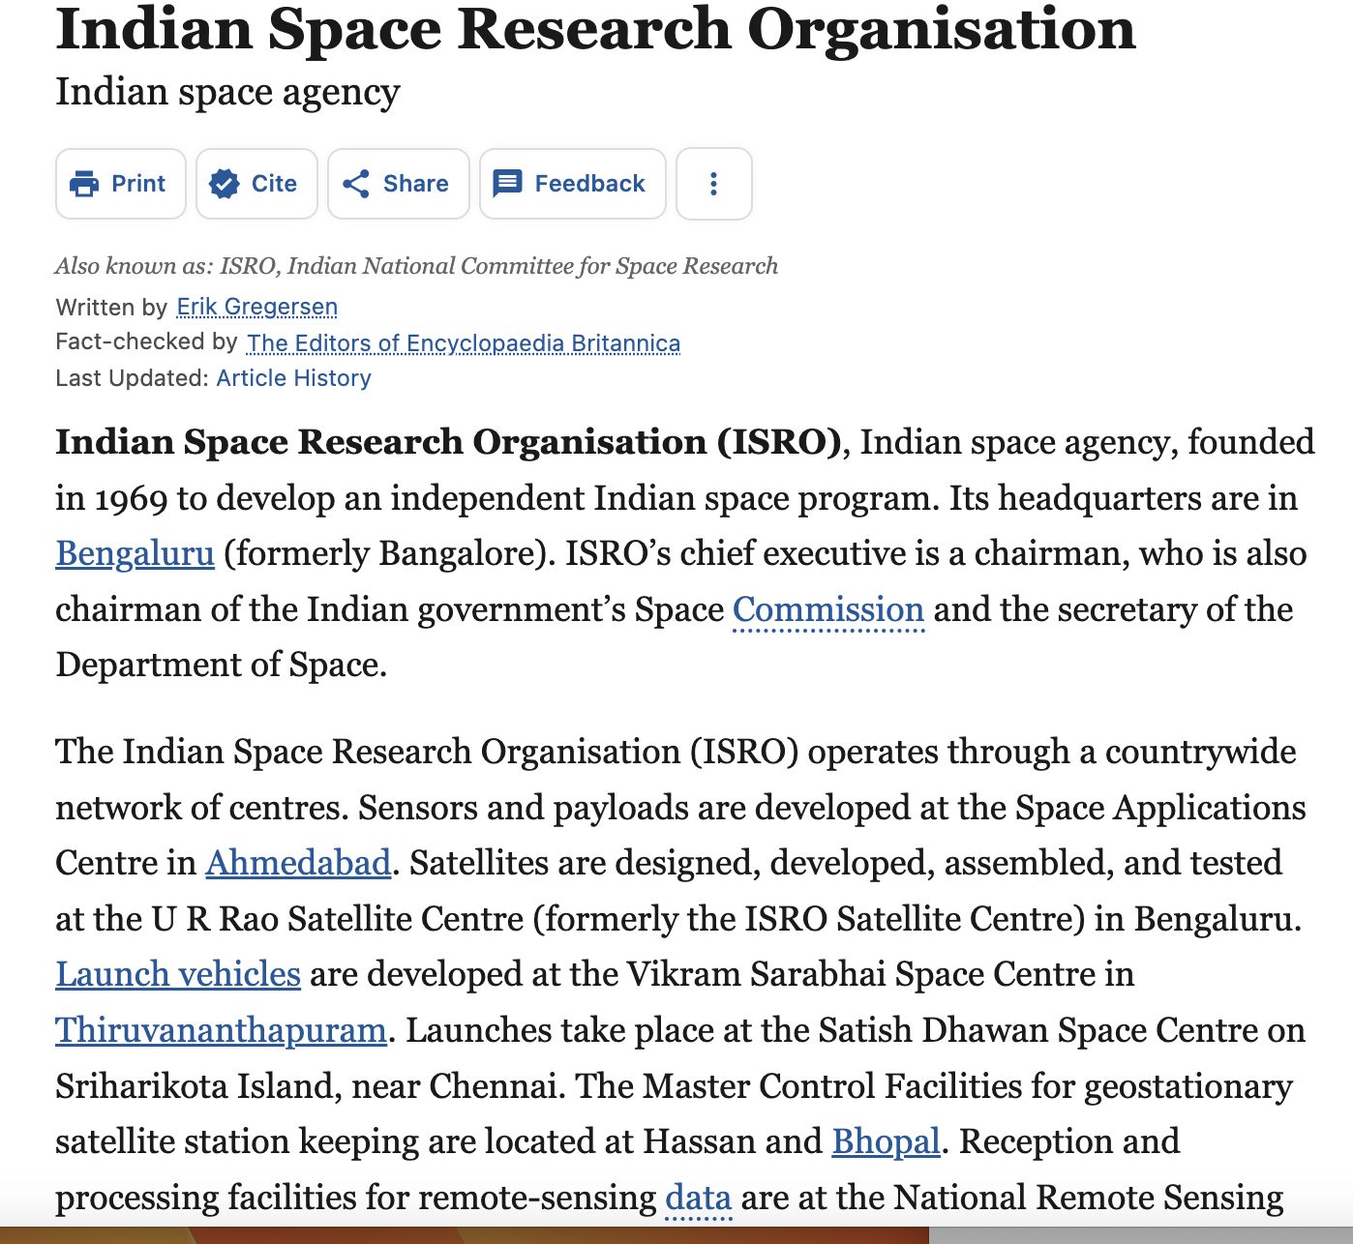
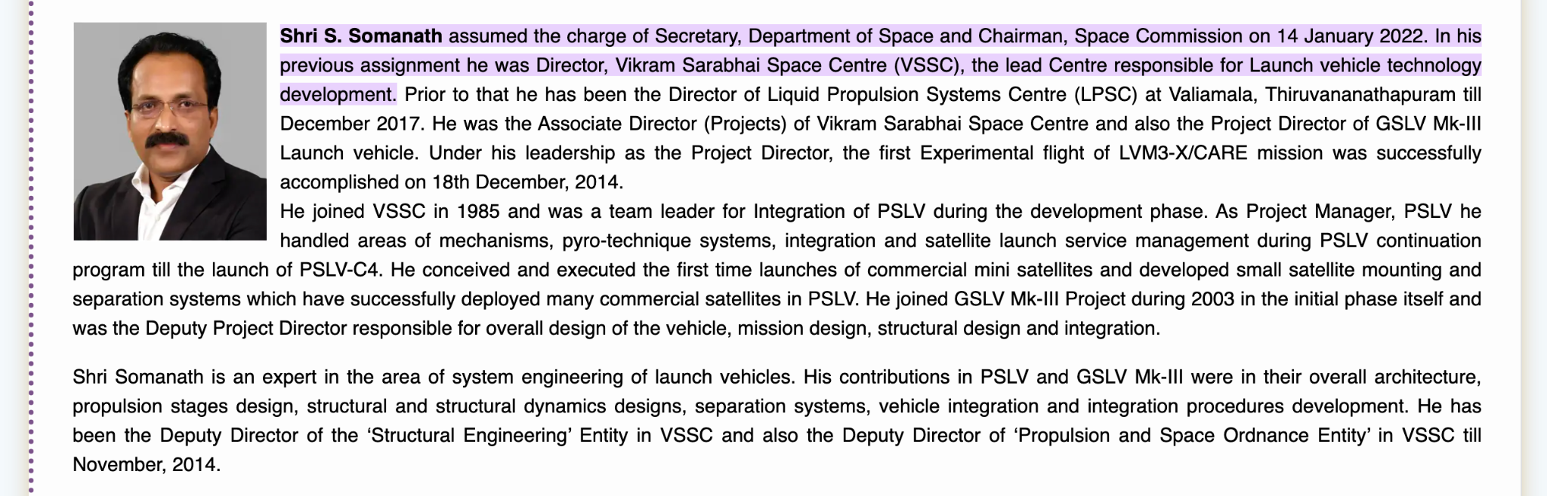
Are these two pages about the same entity?

Slide 33
Pronouns and Determiners
Pronouns are a class of words that act like variables
They refer to a person or thing that is important in the discourse context
I have bought the new Tata Tigor. It’s a marvelous car with smooth pick-up.
My daughter wanted a new car. We chose the new Renault Kwid. It’s the perfect car for her
The lazy fox jumped over the blue moon
Not all foxes jump over all moons

Slide 34
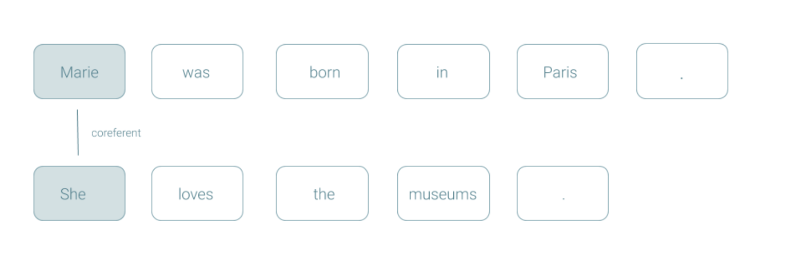
Coreference resolution
Coreference resolution (CR) is the task of finding all linguistic expressions (called mentions) in a given text that refer to the same real-world entity. After finding and grouping these mentions we can resolve them by replacing, as stated above, pronouns with noun phrases.

Slide 35
Adverbs, Prepositions, Particles
What do you think of my dress?
It’s good.
It’s very nice!
It’s bad!
It’s not bad! Adverb makes a difference
I sit on the bench but wade in water – spatial relationships
Particles are a subclass of prepositions that enter into strong bonds with verbs to create PHRASAL VERBS that become separate lexical entry
I was put off by the remarks

Slide 36
NLP Tools for linguistic analysis of documents
An integrated suite of natural language processing tools to process text using Java
Tokenization
Part-of-speech tagging
Parsing
Coreference resolution
Named entity recognition

Slide 37
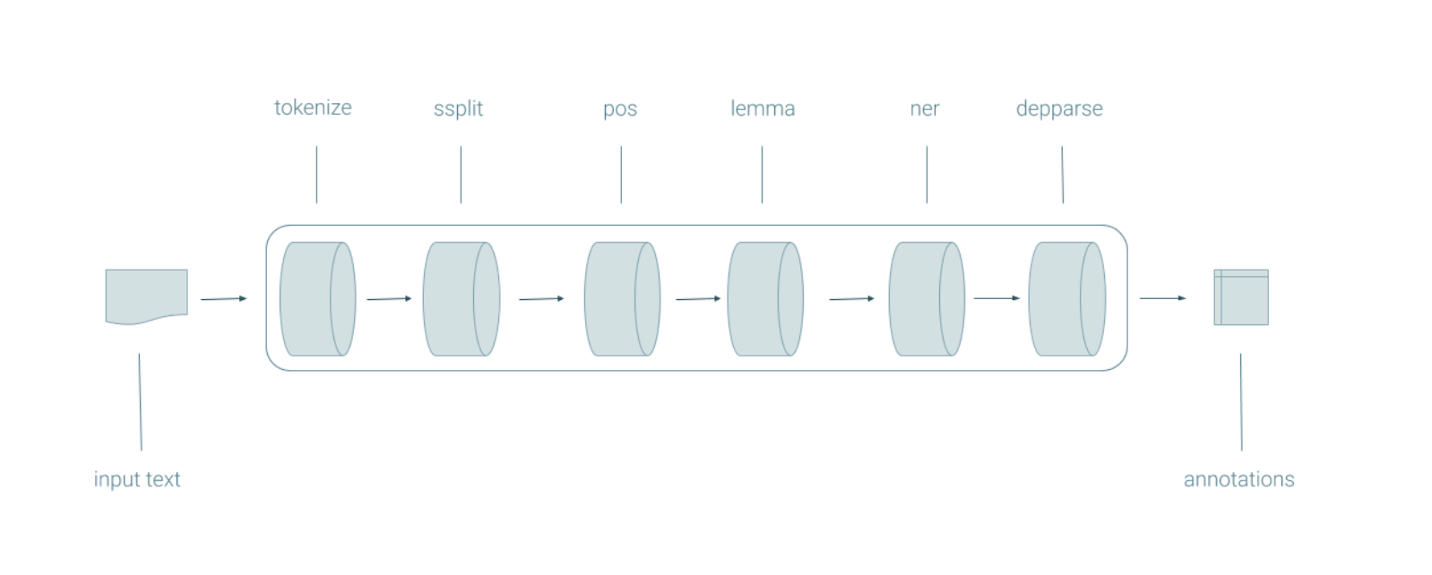
Core NLP - Stanford
https://stanfordnlp.github.io/CoreNLP/index.html

Slide 38
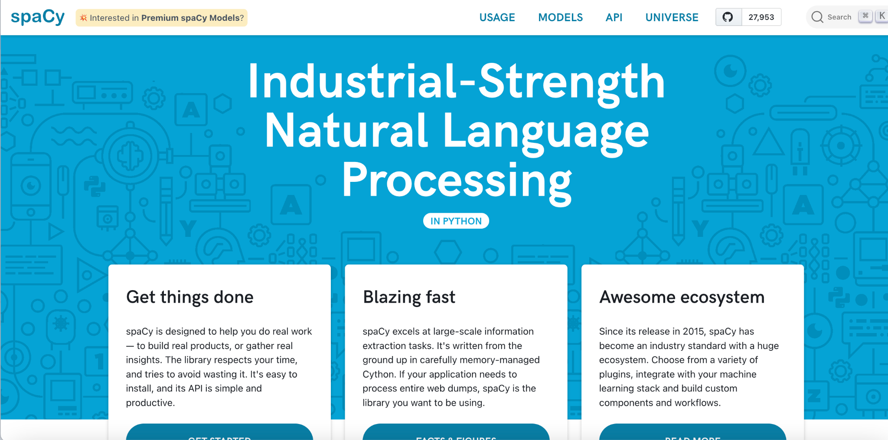
Spacy - industrial strength NLTK
https://spacy.io/

Slide 39
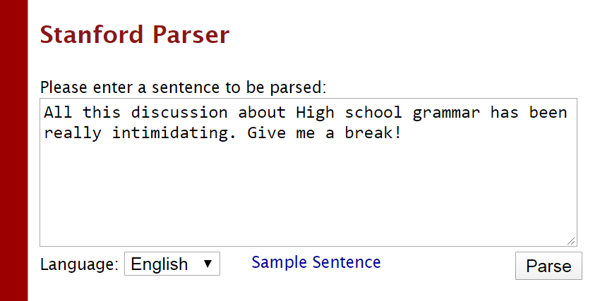
POS Tagging of Words
All/PDT this/DT discussion/NN about/IN High/JJ school/NN grammar/NN has/VBZ been/VBN really/RB intimidating/JJ ./.
Give/VB me/PRP a/DT break/NN !/.

Slide 40
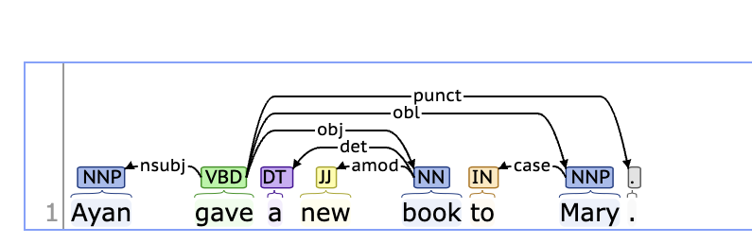
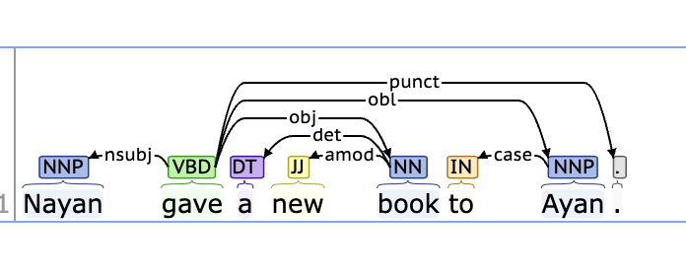
Phrase Trees
Who / What are the Subjects and Objects in a sentence

Slide 41
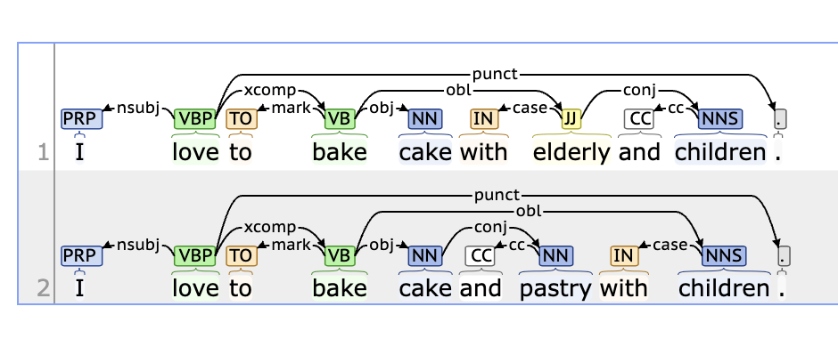
Dependencies as relations

Slide 42
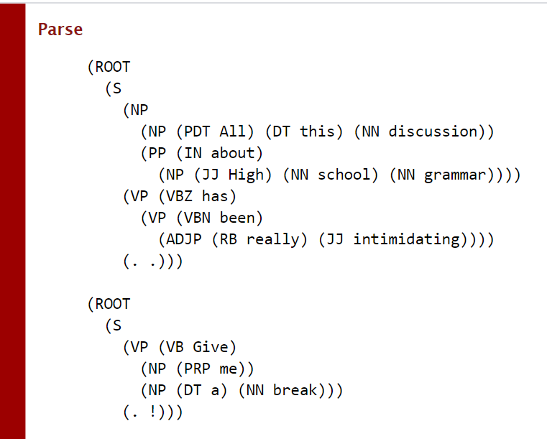

Slide 43
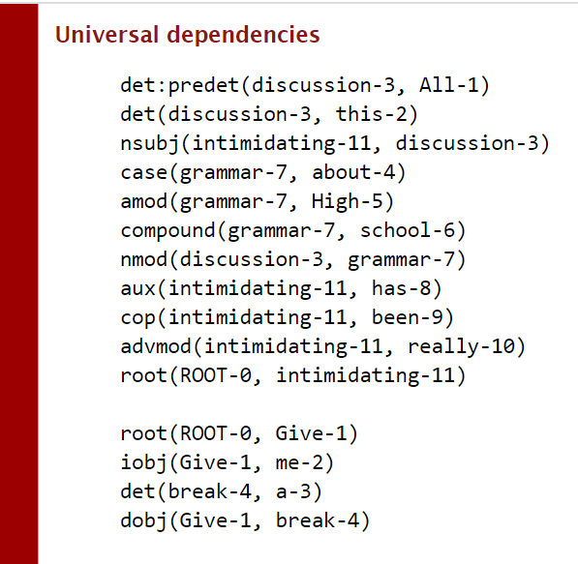

Slide 44
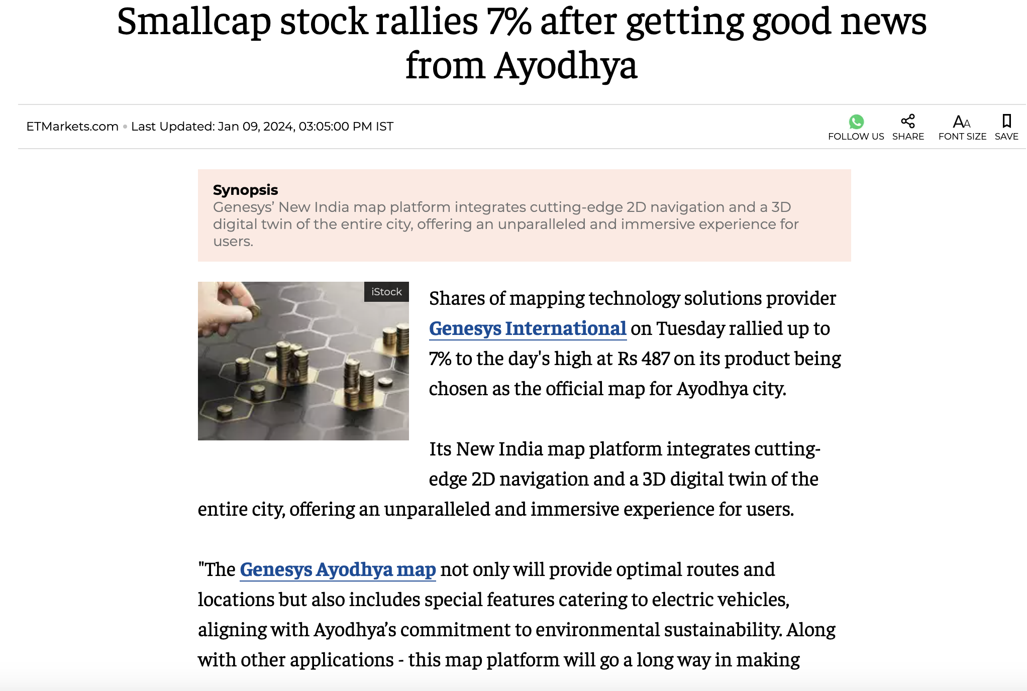
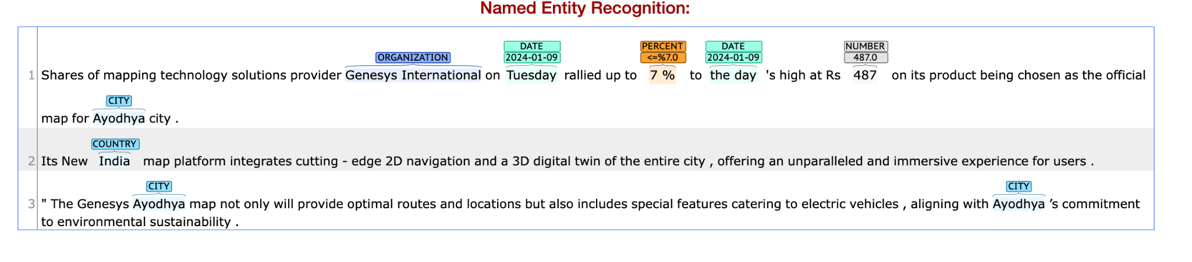
Uses of NER in Text Processing Tasks
Which are the organizations, cities, numeric quantities mentioned in the News?

Slide 45
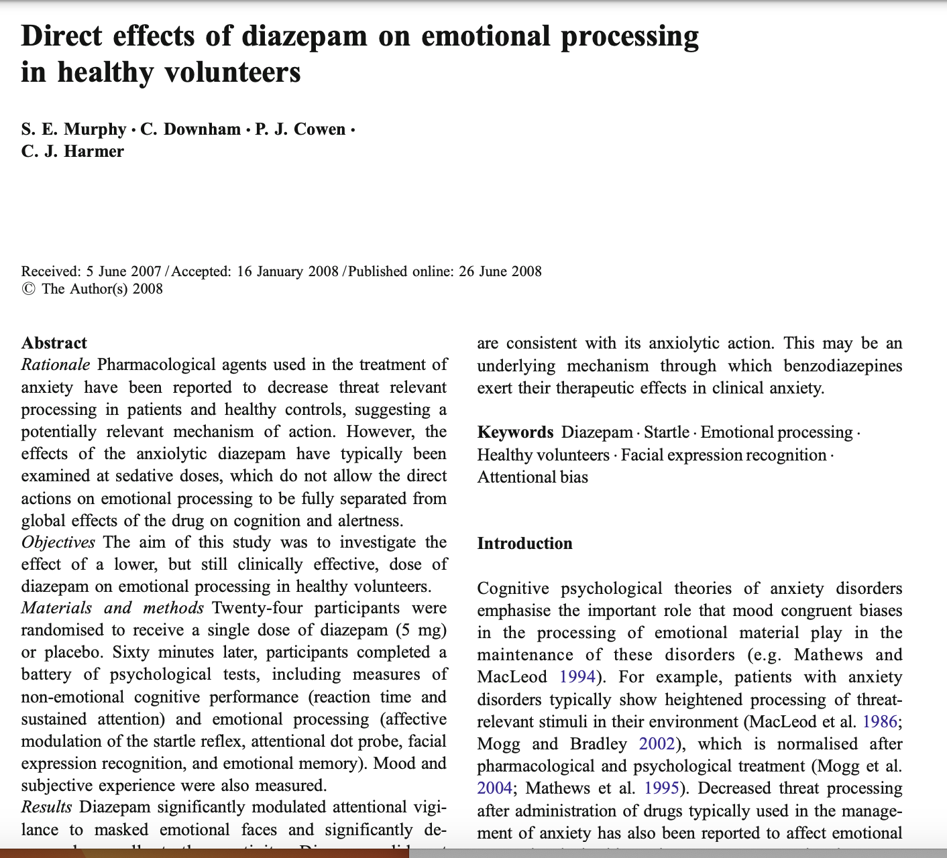
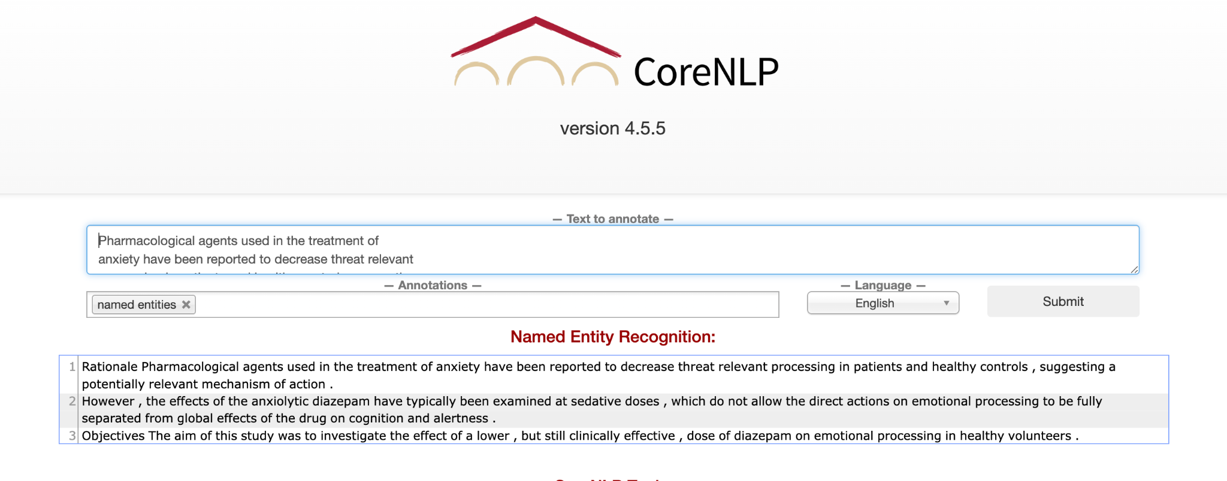
Are NERs available for all tasks?
Task - Identify the drugs mentioned in the following PubMed articles.
Domain - specific NERs have to be created

Slide 46
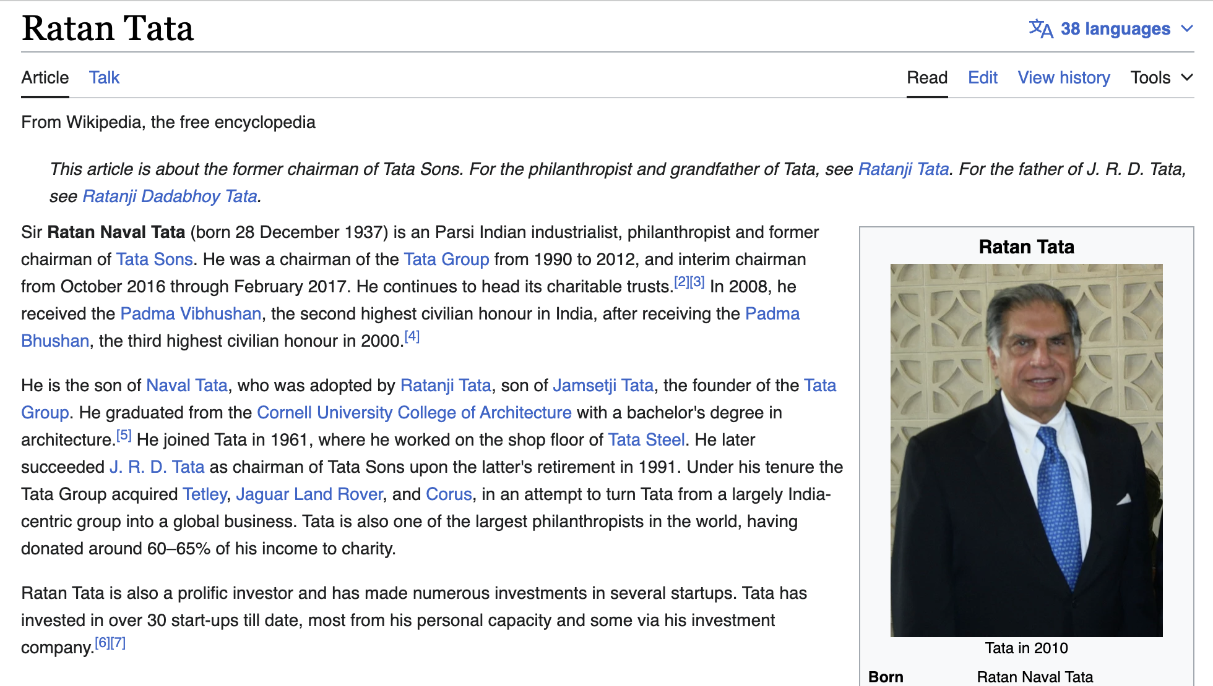
Coreference Resolution
Who is Ratan Tata’s father?
Is Ratan tata a philanthropist?

Slide 47
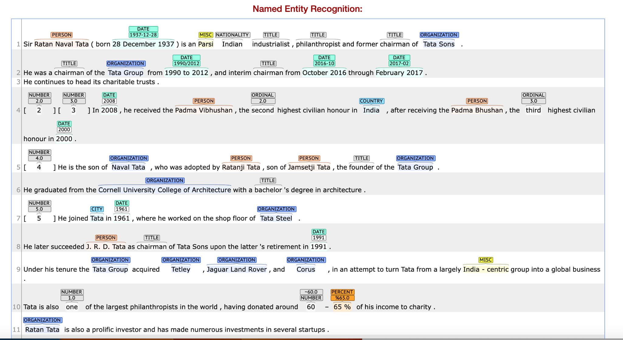

Slide 48
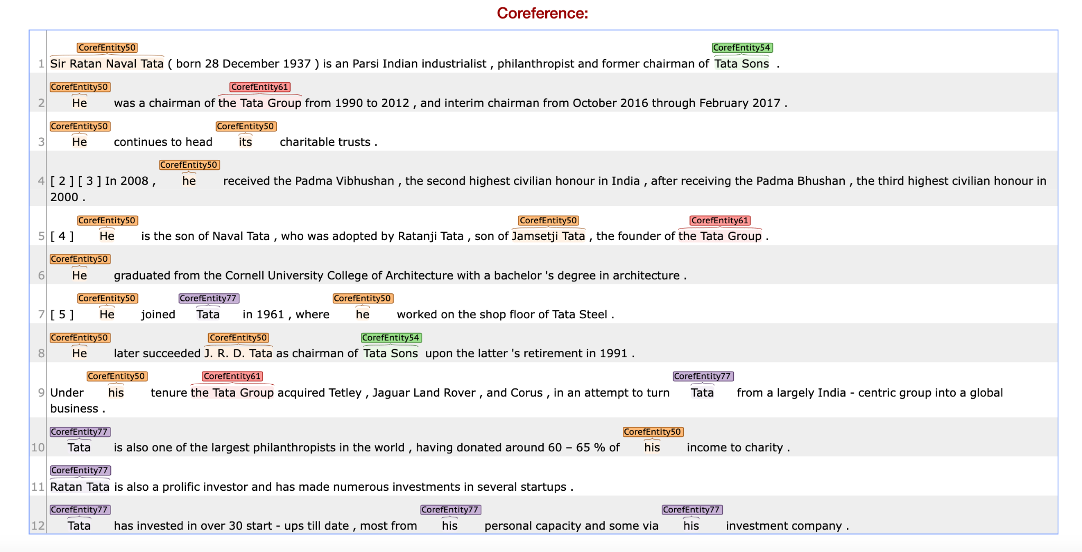

Slide 49
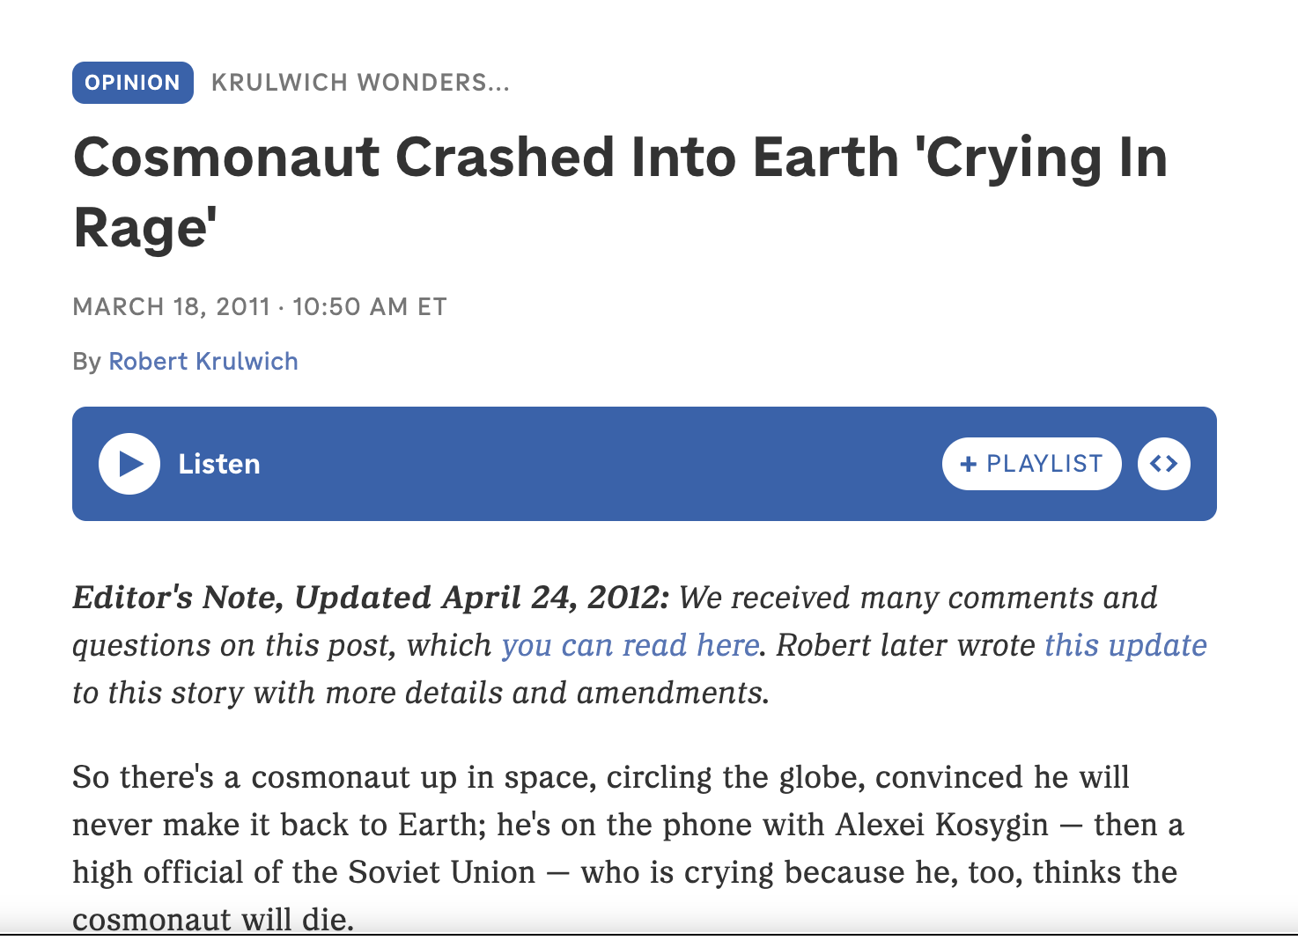
What makes NLP difficult - Word Sense
Polysemy - Same words can mean different things!
I have watered the plants
This course is watered down.
Synonyms - Find me all News on “astronauts”
Metonyms - figure of speech that replaces the
name of an object or concept with a closely related word
This dish tastes good
Hyponyms / Hypernyms - general / specific
I love Chinese food → I love Chow Mein
Is this relevant?

Slide 50
What makes NLP difficult - Word Sense
Hyponyms / Hypernyms - general / specific
I love Chinese food → I love Chow Mein
Meronyms - Part - whole relationship
The car is blue → Its doors are blue
Antonyms - Opposites
He said the movie is good while she said it’s bad → Opposite sentiments

Slide 51
Discourse Analysis
John took a train from Paris to Istanbul. He likes spinach.
Jane took a train from Paris to Istanbul. She had to attend a conference.
Are these two sentences equally coherent?
Reason?
How to measure coherence?

Slide 52
What can incoherence indicate
Mental Health Issues
Incoherent text messages used to identify stroke
I am very happy. She didn’t drink the milk today
Tjhe Doctor nddds a new bb

Slide 53
Events
Citing high fuel prices, United Airlines said on Friday it has increased fares by $6 per round trip on flights to some cities also served by lower-cost carriers.
American Airlines, a unit of AMR Corp., immediately matched the move, spokesman Tim Wagner said.
United, a unit of UAL Corp., said the increase took effect Thursday and applies] to most routes where it competes against discount carriers, such as Chicago to Dallas and Denver to San Francisco.
India’s largest IT services company Tata Consultancy Services (TCS) on January 11 reported that its deal total contract value (TCV) for the third quarter ended December 31, came in at $8.1 billion, missing the company’s quarterly deal win guidance of $9-10 billion.
Infosys announced an agreement to acquire InSemi, a semiconductor design and embedded services provider.

Slide 54
Questions

